Slide 1


3D Graphics
Workshop 6

Slide 2
vector
A vector has magnitude (size) and direction
magnitude

Slide 3
Representing vector
Using two numbers e.g. (3,4) in a 2D space
0 1 2 3 4 5 6 7 8
0 1 2 3 4 5 6 7 8 9 10

Slide 4

Length of a vector
v = (3,4)
|v| = sqrt(3² + 4²)
= 5
0 1 2 3 4 5 6 7 8
5
0 1 2 3 4 5 6 7 8 9 10

Slide 5
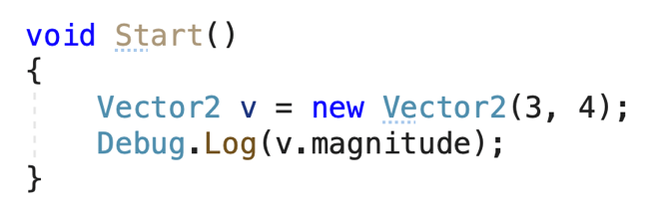

Vector magnitude
Vector2 is used to model a Mathematics Vector.

Slide 6

Vector normalisation
Transform the vector to a unit vector
Unit vector has a length of 1
v = (3,4)
norm v = (3/5 , 4/5)
= (0.6,0.8)
Length of (0.6,0.8)
= sqrt(0.6² + 0.8²) = 1
0 .2 .4 .6 .8 1 1.2 1.4 1.6
1
0 .2 .4 .6 .8 1 1.2 1.4 1.6 1.8 2

Slide 7
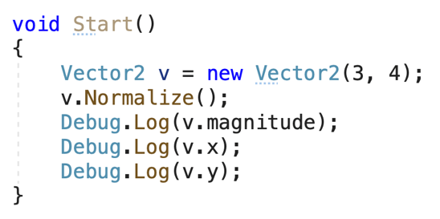
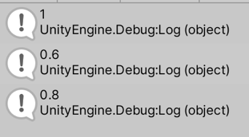
Vector normalisation

Slide 8

Multiplication by a scalar
A scalar is a single number
a = 5
v = (3,4)
av = (5x3,5x4) = (15,20)
0 5 10 15 20 25 30 35 40
0 5 10 15 20 25 30 35 40 45 50

Slide 9
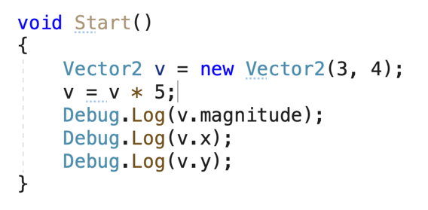
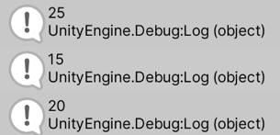
Vector scalar Multiplication

Slide 10

Negating a vector
Change the direction of a vector
v = (3,4)
-v = (-3,-4)
-4 -3 -2 -1 0 1 2 3 4
-3 -2 -1 0 1 2 3 4 5 6 7

Slide 11
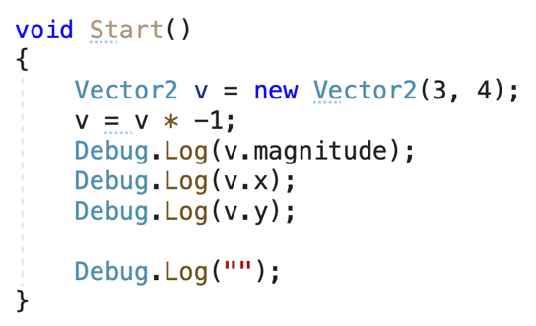
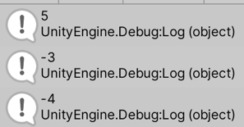
Vector Negating

Slide 12


Adding vectors
You can add two vectors by simply joining them head-to-tail:
And it doesn't matter which order you add them, you get the same result:

Slide 13
Adding vectors
vector A (3,4) add vector B,(5,3)
0 1 2 3 4 5 6 7 8
0 1 2 3 4 5 6 7 8 9 10

Slide 14
Adding vectors
vector A (3,4) add vector B,(5,3)
New x is 3 + 5 = 8
New Y is 4 + 3 = 7
0 1 2 3 4 5 6 7 8
0 1 2 3 4 5 6 7 8 9 10

Slide 15
Adding vectors
vector A add vector B (3,4),(5,3)
The new resultant vector
is (8,7)
0 1 2 3 4 5 6 7 8
0 1 2 3 4 5 6 7 8 9 10

Slide 16
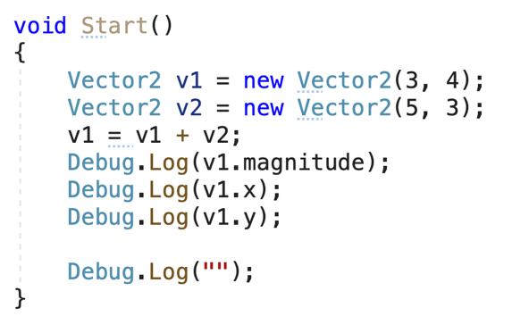
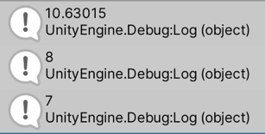
Adding Vectors

Slide 17
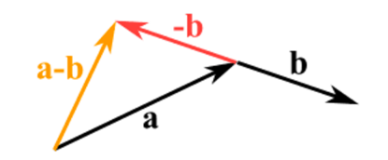
Subtract vector
Reverse the direction of the vector we want to subtract,
Then add them as usual:
E.g. (5,3) – (3,4)
= (5,3) + (-3,-4)
= (5-3 , 3-4)
= (2,-1)

Slide 18
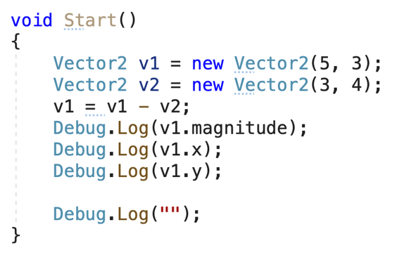
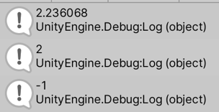
Subtract vector

Slide 19
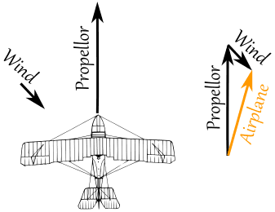
Use of Vector to model
The two vectors (the velocity caused by the propeller, and the velocity of the wind) result in a slightly slower ground speed heading a little East of North.

Slide 20
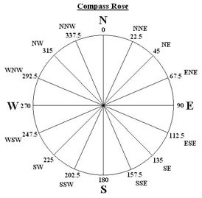
What is velocity?
Velocity is speed with a direction.
If an object is moving at 10 km/h that is a speed.
If the object is moving at 10 km/h at 45º that is a velocity.

Slide 21

Representing velocity
0 1 2 3 4 5 6 7 8
0 1 2 3 4 5 6 7 8 9 10

Slide 22
Representing velocity
In one time unit, the location will move by x unit and y unit of velocity.
Location => (2,3)
0 1 2 3 4 5 6 7 8
0 1 2 3 4 5 6 7 8 9 10

Slide 23
Representing velocity
Time unit 1
New X = 2+3 = 5
New Y = 3+2 = 5
New Location => (5,5)
0 1 2 3 4 5 6 7 8
0 1 2 3 4 5 6 7 8 9 10

Slide 24
Representing velocity
Time Unit 2
New X = 5+3 = 8
New Y = 5+2 = 7
New Location => (8,7)
0 1 2 3 4 5 6 7 8
0 1 2 3 4 5 6 7 8 9 10

Slide 25
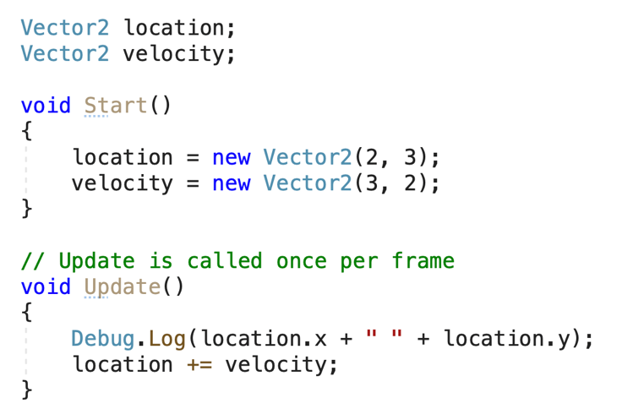
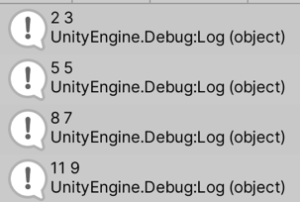
Modelling

Slide 26
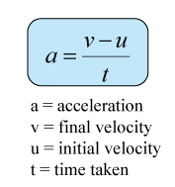
What is acceleration?
The acceleration of an object is the change in its velocity over a period of time,
The units for acceleration are distance/time²

Slide 27

What is acceleration?
Time unit 0 – starting point
0 | 1 | 2 | 3 | 4 | 5 | 6 | 7 | 8
Distance unit
Distance Travelled : 0 distance unit
Velocity: 0 distance unit/time unit

Slide 28
What is acceleration?
Time unit 1
0 | 1 | 2 | 3 | 4 | 5 | 6 | 7 | 8
Distance unit
Distance Travelled : 2 distance unit
Velocity: 2 distance unit/time unit

Slide 29
What is acceleration?
Time unit 1
0 | 1 | 2 | 3 | 4 | 5 | 6 | 7 | 8
Distance unit
Instantaneous Velocity at
this point: 2 distance unit/time unit
Distance Travelled : 2 distance unit
Velocity: 2 distance unit/time unit
Acceleration = (final velocity - initial velocity)/time unit taken
= (2-0)/1
= 2 time unit/time unit²

Slide 30
What is acceleration?
Time unit 2
0 | 1 | 2 | 3 | 4 | 5 | 6 | 7 | 8
Distance unit
Instantaneous Velocity at
this point: 2 distance unit/time unit
Instantaneous Velocity at
this point: 2 distance unit/time unit
Distance Travelled : 2 distance unit
Velocity: 2 distance unit/time unit
Acceleration = (final velocity - initial velocity)/time unit taken
= (2-2)/1
= 0 distance unit/time unit²

Slide 31
What is acceleration?
What if the car travels 4 distance units?
Time unit 2
0 | 1 | 2 | 3 | 4 | 5 | 6 | 7 | 8
Distance unit
Instantaneous Velocity at
this point: 4 distance unit/time unit
Instantaneous Velocity at
this point: 2 distance unit/time unit
Distance Travelled : 2 distance unit
Velocity: 2 distance unit/time unit
Acceleration = (final velocity - initial velocity)/time unit taken
= (4-2)/1
= 2 distance unit/time unit²

Slide 32
Velocity and Acceleration
Time 0
0 | 1 | 2 | 3 | 4 | 5 | 6 | 7 | 8
Velocity : 0 distance unit/time unit
Acceleration : 0 distance unit/time unit²
Time 1
0 | 1 | 2 | 3 | 4 | 5 | 6 | 7 | 8
Velocity : 2 distance unit/time unit
Acceleration : 2 distance unit/time unit²
Time 2
0 | 1 | 2 | 3 | 4 | 5 | 6 | 7 | 8
Velocity : 2 distance unit/time unit
Acceleration : 0 distance unit/time unit²
Time 3
0 | 1 | 2 | 3 | 4 | 5 | 6 | 7 | 8
Velocity : 2 distance unit/time unit
Acceleration : 0 distance unit/time unit²
Constant velocity after time 1
0 acceleration after time 2

Slide 33
Graph the Velocity and Acceleration
v
a
0 1 2 3 4
0 1 2 3 4
t
t
0 1 2 3
0 1 2 3
Velocity
Acceleration

Slide 34
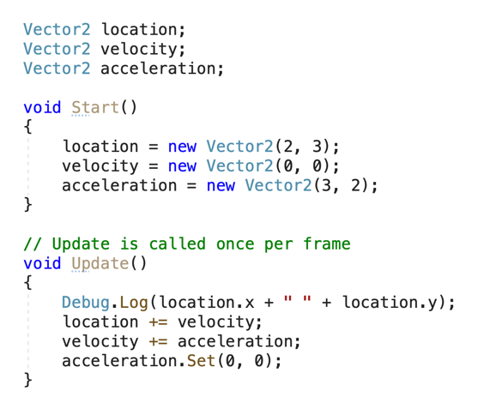
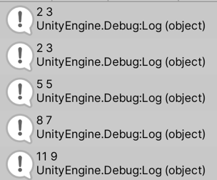
Modelling

Slide 35
Velocity and Acceleration
Time 0
0 | 1 | 2 | 3 | 4 | 5 | 6 | 7 | 8
Velocity : 0 distance unit/time unit
Acceleration : 0 distance unit/time unit²
Time 1
0 | 1 | 2 | 3 | 4 | 5 | 6 | 7 | 8
Velocity : 2 distance unit/time unit
Acceleration : 2 distance unit/time unit²
Time 2
0 | 1 | 2 | 3 | 4 | 5 | 6 | 7 | 8
Velocity : 4 distance unit/time unit
Acceleration : 2 distance unit/time unit²
Velocity : 6 distance unit/time unit
Acceleration : 2 distance unit/time unit²
Time 3
0 | 1 | 2 | 3 | 4 | 5 | 6 | 7 | 8
9 | 10 | 11 | 12
Increasing velocity, and
constant acceleration after time 1

Slide 36
Graph the Velocity and Acceleration
v
a
0 1 2 3 4 5 6
0 1 2 3 4
t
t
0 1 2 3
0 1 2 3
Velocity
Acceleration

Slide 37
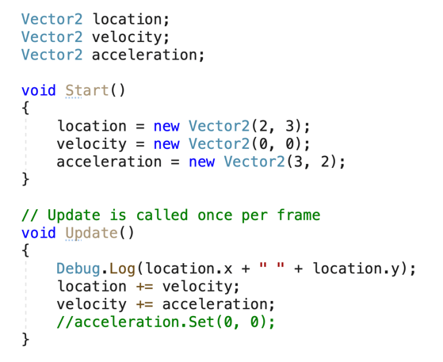
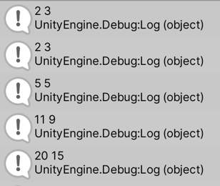
Modelling
Note: the acceleration is constant and the velocity is forever increasing.

Slide 38
FORCE AND VECTOR
A force is a vector that causes an object with mass to accelerate.
Vector in Math
a matrix with either one row or one column
Use Vector2 and Vector3 to represent force in Unity3D C#.

Slide 39
NEWTON’S SECOND LAW
Force equals mass times acceleration. (f=ma)
f – vector
a – vector
m – scalar
Acceleration is
directly proportional to force and § inversely proportional to mass.
This means that if you get pushed,
the harder you are pushed, the faster you’ll move (accelerate).
directly proportional to force
the bigger you are, the slower you’ll move.
inversely proportional to mass

Slide 40



NEWTON’S SECOND LAW
Re-arranging the equation (f=ma),
the total acceleration of an object is the sum of all the forces acting on the object divided by its mass:
The force of gravity is calculated relative to an object’s mass. The bigger the object, the stronger the force.
f1
f2
m
f3

Slide 41
MODELLING FORCES
From this equation we can see that the basic function of a physics engine is to
evaluate all of the forces on an object, sum them to calculate the acceleration and
then use the acceleration to update the velocity and position.
f1
f2
m
f3

Slide 42
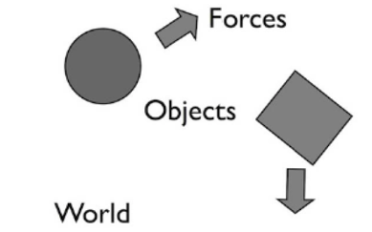
PHYSICS ENGINES
A piece of software for simulating physics in an interactive 3D graphics environment.
Perform the simulation behind the scenes and make it easy to set up complex simulations.

Slide 43
Using Vector2 to model force
Complete Workshop 6 Lab 1
This lab gives us an idea of how a Physics engine model different type of forces.

Slide 44
Converting Coordinate
Complete Workshop 6 Lab 2
This lab shows us how to convert the screen coordinate to world screen coordinate to control a player game object.

Slide 45
Ray cast
In the previous lab, if the main camera is not perpendicular to the plane, the player game object starts to tilt look at the mouse.
To overcome this, we need to use Ray cast
Complete Workshop 6 Lab 3 on Ray cast.

